Slide 1
MDM & DI&O Update
ITLT Tech TaskForce

Slide 2
NG Data Strategy – Fixing Data
‘Purple Top’ – May 2020
What is our Data problem and what is it costing us?
Based on recent work by Boston Consulting Group, National Grid rates “low” or “very low” across the three major components of Data (Master Data Solutions, Data Governance, and Data Tools & Platforms). BCG’s study, that looked into a subset of the Data domains at National Grid, estimated the costs of bad Data are $73-98M. Given the limited scope of their review, they concluded that the full cost is likely much higher.”
Analysis of the Current State of Data at National Grid by BCG dated April 7th, 2020.
To addresses these issues, we need three key components to “Fix Data”:
Data Governance & Stewardship – Business ownership of data, accelerated by BMS
Data Tools & Capabilities – One, common approach to Enterprise Data solutions
Master Data Solutions – for each data domain, establish a data master

Slide 3






National Grid “Data Framework”
Business Strategy
Data Strategy
Strategy
Collaboration
BMS Standard
Governance & Standards
People
Culture
Process
Principles & Policies
Master Data Management
Data Platform
EDP Architecture & Modelling
Business Intelligence
Big Data
Analytics & AI
Data Quality
Data Capabilities
Data Tools support Capabilities
Data Catalog
& Management
Data Integration
Metadata Management
Business
Technical
Notes:
© Copyright Showeet.com

Slide 4
Master Data Management Platform Business Demand
AMI
Domains: Customer, Asset, Location, Workforce, Reference
Allocated MDM license cost in FY2022 approved budget
Required by Jun/Jul 2021
GridMod
Domains: Asset, Location, Workforce, Reference
Allocated MDM license cost in FY2022 approved budget
Required by Jun/Jul 2021
US Customer Transformation
Domains: Customer B2C, Workforce, Vendor, Product, Reference
FY2022 Business case includes MDM license cost
IAM
Domains: Workforce, Reference
Workforce Data Domain
Domains: Workforce, Reference
FY2022 Business case has included MDM license cost
Digital Enablement
Domains: Customer, Workforce, Asset, Location, Reference
Programs: OnMyWay, FutureNow, VMO, Smart Target etc.
RIO based UK-ET and UK-GT initiatives
Domains: Customer B2B, Workforce, Asset, Location, Vendor, Product, Reference
ESO
Domains: Customer B2B, Workforce, Asset, Location, Reference
Energy Efficiency/Clean Energy initiative
Domains: Customer, Workforce, Reference

Slide 5
DI&O and MDM Use Cases - Demand
 |  | US Networks | UK Networks | UK ESO (*CNI) | Group Functions & NGV
Data Integration & Orchestration | Use cases | Increase network visibility Share key information with customers / market More timely / accurate customer information Leverage devices to improve field operations Situational awareness capabilities Digital products – Vegetation Management Optimization (VMO) | Image & Video Analytics for Asset Condition GIS Integration Data Science & Collaboration platform AI Modelling for alarm processing, incident analysis, safety & performance simulation & impact/restoration assessments Setup AI Platform & small use cases Pilot AI & DeX for Network Safety, Business Performance & Customer Experience Asset Performance Modelling AI Modelling for Network Optimization Energy Trading Reporting & Notifications Digital products – Site intelligence, Asset Intelligence, Gaia, Solution lab | Electricity Market Reform Demand Forecasting Outage Planning Settlements Network Modelling Network Operability Predictive Analytics Advanced Search Situational Awareness* Future of Balancing* | Identify Access Management (IAM) improvements & integration Real-time & informed decision making Regulatory compliance Efficient reporting process Improved quality of leadership and decision-making Drive greater insight and predictability Robust workforce management Unlock strategic workforce planning AI CV Screening and Blind CV Employee Survey
 | Enabler Investments | AMI, GridMod US Customer Transformation US Customer Stabilization | Core Cloud based data platform Modelling Services Analytics Services | Digital Engagement Platform Insights & Analytics Platform | Workforce Data Domain Analytics services NGV insights / analytics
Master Data Management | Use cases | Improve system efficiency Improve data accuracy More timely / accurate customer information Digital products - OnMyWay, FutureNow, VMO | Asset Performance Modelling Enhance Asset Design (BIM) New Information Provision, MIPI Digital products – Site intelligence etc | Network Modelling Network Operability Predictive Analytics | IAM initiative – Every worker will get unique ID Global Workforce Tracking (GWT) for Non Employee Data (Contingent, Managed Services Provider (MSP))
 | Enabler Investments | AMI, Grid Mod US Customer Transformation US Asset | MDM Platform | Digital Engagement Platform Insights & Analytics Platform | My HR 2.0 (MyHub) Workforce Data Domain (WDD)

Slide 6








Enterprise Data Platform – Arial View
App/Service
(3rd Party)
AI/ML
Data
Science
Streaming
Analytics
Web/Portal
Consume
Ops
BI/Viz
MDM
Data Quality
Data Catalog
Integration
Service
Process
& Serve
Data Lake / Raw
(Landing)
Cached Transactional
(ODS, Ops)
Curated Foundational Layer
(DWH)
Aggregated Data Layer
(DM)
Data Architecture & Design
Ingest
Structured, semi-structured and unstructured Data
Data Ingest: Batch Pipeline, CDC, Streams, Triggers
ERP/CRM
IoT
OLTP
Mainframe
Source
APIs
Logs
Social Media
& Sentiment Data
3rd Party
SAP, Salesforce, Service Now, Maximo, other
MDM
Data Quality
Data Catalog
Data Archival
Data D/R
Data Protection

Slide 7
Master Data Management High Level Architecture

Slide 8
Digital Transformation – Information Capabilities Pillars
Data Catalog & Governance
Data Quality
(Data Trust)
Master Data Management
Info Governance, Data Analytics & Advanced Analytics
Data Integration & Orchestration
Cloud Data Platform
Data Architecture
(Corporate Models and Standards)
ER/Studio
Informatica
Informatica
Matillion
Reltio
Snowflake
Power BI, TBD
Business transformation alignment & enablement
New technology & architecture discovery and enablement – 6 month to 5 year event horizon
Global and regional consulting support at program and project scope

Slide 9
Enterprise Data Tools Roadmap
1H FY’21
2H FY’21
Q1 FY’22
Q2 FY’22
Q3 FY’22
Q4 FY’22
Data Analytics & Reporting
Power BI
GA – Oct ‘19
Data Modeling
ER/Studio
GA – Aug ‘20
Data Quality/Profiling
Informatica CDQ
Planned GA – Mar ‘21
FY21
Enterprise Data Analytics Platform
Snowflake
Planned GA – Mar ‘21
Data Catalog & Data Governance
Informatica Data Catalog & Axon Data Governance
Planned GA – Mar ‘21
Data Integration & Orchestration
Matillion
Planned GA – Apr ‘21
Master Data Management
Reltio
Planned for FY ‘22
FY22
Advanced Analytics, Machine Learning & AI
TBD
Working with EA to finalize Enterprise AI/ML Tools.
Capability already exists to provide Data Preparation support to the Data Science Teams.

Slide 10
Appendix

Slide 11
Data Catalog, Governance & Quality - Demand
 |  | US Networks | UK Networks | UK ESO (*CNI) | Group Functions & NGV
Data Catalog & Governance | Use cases | Increase network visibility Share key information with customers / market More timely / accurate customer information Leverage devices to improve field operations Situational awareness capabilities Digital products - OnMyWay, FutureNow, VMO | Image & Video Analytics for Asset Condition AI Modelling for alarm processing, incident analysis, safety & performance simulation & impact/restoration assessments Pilot AI & DeX for Network Safety, Business Performance & Customer Experience Asset Performance Modelling AI Modelling for Network Optimization Digital products – Site intelligence, Asset Intelligence, MIPI | Electricity Market Reform Demand Forecasting Outage Planning Network Modelling Network Operability Predictive Analytics Advanced Search | Identify Access Management (IAM) improvements & integration Regulatory compliance Efficient reporting process Drive greater insight and predictability Robust workforce management Unlock strategic workforce planning
 | Enabler Investments | AMI, Grid Mod US Customer Transformation US Asset | Core Cloud based data platform Modelling Services Analytics Services | All RIIO-T2 Investments eg. Insights, analytics, forecasting etc | Workforce Data Domain (WDD)
Data Quality | Use cases | Improve data accuracy More timely / accurate customer information Digital products - OnMyWay, FutureNow, VMO | AI Modelling for alarm processing, incident analysis, safety & performance simulation & impact/restoration assessments AI Modelling for Network Optimization Geospatial Information Systems Digital products – Site intelligence, Asset Intelligence, MIPI | Situational Awareness* Future of Balancing* Demand Forecasting | IAM initiative – Every worker will get unique ID Regulatory compliance Improved quality of leadership and decision-making
 | Enabler Investments | AMI, Grid Mod US Customer Transformation US Asset | Core Cloud based data platform Modelling Services Analytics Services | Digital Engagement Platform Insights & Analytics Platform | My HR 2.0 (MyHub) Workforce Data Domain (WDD) NGV insights / analytics

Slide 12
Data Analytics & AI/ML- Demand
 |  | US Networks | UK Networks | UK ESO (*CNI) | Group Functions & NGV
Data Analytics / Advanced Analytics | Use cases | Increase network visibility Share key information with customers / market More timely / accurate customer information Leverage devices to improve field operations Situational awareness capabilities Damage assessment Smart device status reports Asset health analytics Maintenance resource forecast Digital products - OnMyWay, FutureNow, VMO | Image & Video Analytics for Asset Condition Data Science & Collaboration platform AI Modelling for alarm processing, incident analysis, safety & performance simulation & impact/restoration assessments Setup AI Platform & small use cases Pilot AI & DeX for Network Safety, Business Performance & Customer Experience Asset Performance Modelling AI Modelling for Network Optimization Energy Trading Reporting & Notifications Data Historian Digital products – Site intelligence, Asset Intelligence, Gaia, Solution lab, MIPI | Situational Awareness* Future of Balancing* Electricity Market Reform Demand Forecasting Outage Planning Settlements Network Modelling Network Operability Predictive Analytics Advanced Search | Identify Access Management (IAM) improvements & integration Real-time & informed decision making Efficient reporting process Improved quality of leadership and decision-making Drive greater insight and predictability Robust workforce management Unlock strategic workforce planning Workforce dashboard
 | Enabler Investments | AMI, Grid Mod US Customer Transformation US Asset | Core Cloud based data platform Modelling Services Analytics Services | Digital Engagement Platform Insights & Analytics Platform | Workforce Data Domain (WDD)
AI/ML | Use cases | Improve data accuracy More timely / accurate customer information Load research analytics Demand Forecasting Network Operability Digital products - OnMyWay, FutureNow, VMO | Data Science & Collaboration platform AI Modelling for alarm processing, incident analysis, safety & performance simulation & impact/restoration assessments AI Modelling for Network Optimization Cognitive Technologies Forecaster / Network analysis Digital products – Site intelligence, Solution lab, Gaia, MIPI | Situational Awareness* Digital twin* Simulation* Demand Forecasting Network Operability Predictive Analytics Advanced Search | AI CV Screening and Blind CV Improved quality of leadership and decision-making IAM initiative – Every worker will get unique ID
 | Enabler Investments | AMI, Grid Mod US Customer Transformation US Asset | Core Cloud based data platform Modelling Services Analytics Services | Digital Engagement Platform Insights & Analytics Platform | My HR 2.0 (MyHub) Workforce Data Domain (WDD) NGV insights / analytics

Slide 13
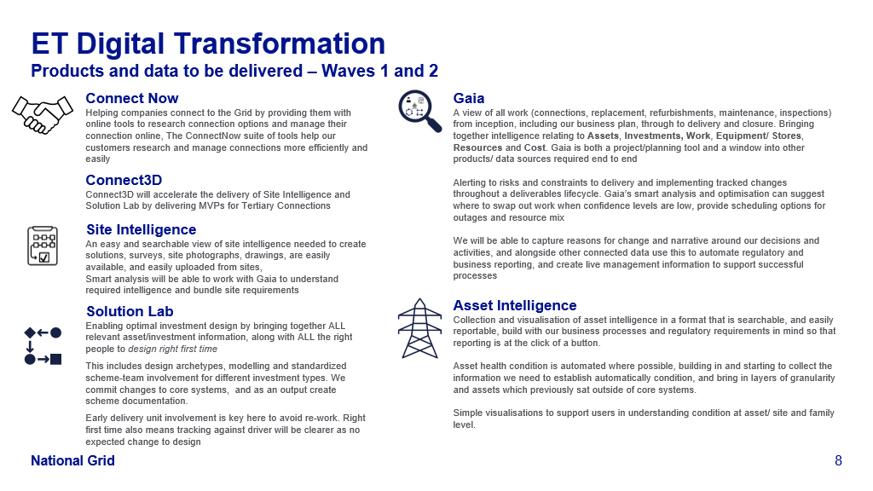

Slide 14
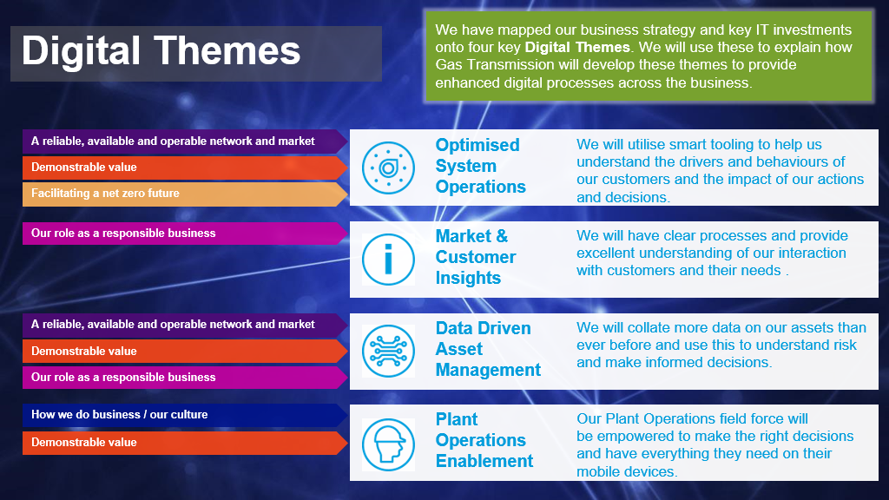

Slide 15
Data Engineering Capabilities – Current State
Data Catalog 
Data Acquisition 
Data Migration 
Data Replication 
Change Data Capture 
Data Movement 
Data Transformation 
Processing Metadata 
People Metadata 
Dataset Metadata 
Data Integration 
Technical Metadata 
Data Flow 
MDM 
Master Data Administration 
Master Index 
Address Standardization 
Matching & Merging 
MDM Hub 
Data Quality 
Data Cleansing 
Data Audits & Control 
Data Platform 
Data Warehouse 
Data Lake 
Operational Data Store 
Data Analytics 
Dashboards 
Reports 
Self Service Analytics 
Mobile BI 
Geospatial Analysis 
Platform Administration 
Data Architecture 
Logical Data Modelling 
Physical Data Modelling 
Advanced Analytics 
AI & Machine Learning Operations 
17 out of 30 sub capabilities fully established.
Remaining 13 sub capabilities will be established in FY22.
Legend  - Established
 - Partially established
 - Not yet established

Slide 16
 | What | Who | Update
1 | BU (& Group – workforce, other?) demand for MDM & DI&O | TT & DS | Next slides
 | EDP platform capabilities available and WIP | BT | From BT deck (or Bryan?) – include in this deck (slide 24 BT deck, 6 & 7 BC deck)
 | Any wider risks issues to the BU’s getting value from these capabilities? Business change?, Data Sovereignty!?, Business Separation?, Grp OpModel gaps? | BC | CIO teams need to establish better clarity of Use Cases and outcomes Data Literacy challenges – how to help?
 | Are there any other EDP capabilities that we can see demand for but are not available/funded? AI/ML? | BC | TT: CDC is a gap but should be coming with Matillion in the near term (STRIIM – tactical) Streaming? We have enough licenses for any needed Anaconda use globally – still need to determine if that’s what is needed
 | The do nothing position – what is the implication of not having these capabilities available A: MDM – tactical solutions failing, higher risk and higher cost and timelines for dependent projects B: DI&O – proliferation of technology (cost) across the Group and Snowflake benefits eroded (cost/time) | BC
 | Funding shortfall and options | TT | TT: We don’t have shortfalls as Narayan has funding ear-marked for our program – we just need to get it approved (sanctioned) DI&O: Looking for 140k Opex if stand-alone 3 month project If this gets embedded into a larger Data Management project, we can minimize the Opex (good) but it will likely cause delays in bringing on the capability due to a likely extended sanction event (bad) RTB is planned to be picked up by projects immediately after standing up the capability (good) MDM: 900k for licensing; engineering hours to stand it up is still pending development (as I understand it)
 | Anything else? |  | TT: Don’t get me up on my soapbox – we need to pivot from “we need the capability” è “when do you need it” è “when will you have it”; vicious circle. Same thing on funding – we can better establish the roadmap for project needs vs availability of capability when we have a better read on what is funded, or the targets for funding – we can answer this in conversations with the CIOs (or their appointees) but I don’t know if anyone has a good read just yet. Final thought: if we wait for projects to be funded to stand up MDM and DI&O, we will delay those projects. If you build it, they will come – we have to stop being their excuse Capabilities for video / picture (unstructured) analysis eg ET OHL dedication from streamed video footage

